Slide 1

Fuzzing basics Or how to break software

Slide 2


About Me
Husband
Avid scuba diver
Hacker & breaker of software ☺
Security worker bee at Company X

Slide 3
Agenda
Why fuzz?
Fuzzing methods
Fuzzing types
Fuzzing software
Lots of examples & samples
These will be posted on https://github.com/griddd/DerbyCon2016 shortly after the con
Tips and tricks
Questions/comments

Slide 4

Why fuzz
It’s fun to break software ☺
To find exploitable bugs…really fun!
Only written a couple exploits so far, but want to do more.
More thorough testing
Input that users and/or programmers often don’t consider
Helps increase software quality
Helps hold your vendors accountable for poorly-written/poorly-tested code!

Slide 5

Fuzzing methods
Manual: inputting stuff yourself
Automated: using fuzzing software or writing your own fuzzer
Wireless: MDK3 in Kali Linux is fun (I’ve only dabbled in this)

Slide 6
Fuzzing types
Local (Fuzzing software installed on your machine)
Pretty much have to do this for exploit development
Gives you full control over the environment
Remote (fuzzing something installed elsewhere; e.g. web application)
Bit more restricted in terms of control; moot point if you can get to the server
Routers, switches, firewalls, etc sitting between you and the target can be problematic
Can alter or drop your traffic…depending on device configuration

Slide 7
Fuzzing software
Basically, anything allowing interaction with the target can be considered a fuzzer
Windows
Peach Fuzzer
BurpSuite
Kali Linux (I use this primarily)
BurpSuite, BED, DOONA, DotDotPwn, Metasploit fuzzer modules, nmap fuzzer scripts, Peach Fuzzer, Spike, OWASP-ZAP

Slide 8
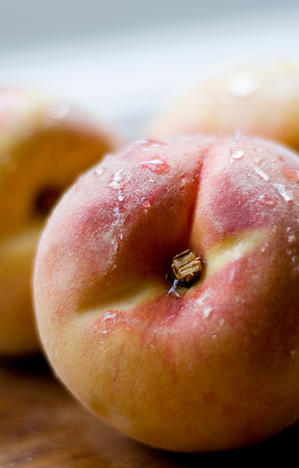
Peach Fuzzer on Windows
See http://community.peachfuzzer.com for further info
Peach pits (fuzz definitions) are done in XML, so a good XML editor is helpful
Free peach pits are available on the Internet
Also see C:\Peach Fuzzer\Samples
Provides good feedback on reproducing crashes, and logging info useful for exploit development
Good tutorials available at http://community.peachfuzzer.com/v3/PeachQuickStart.html
Also check out https://forums.peachfuzzer.com/forum/peach-community-edition/general-support/410-fuzzing-for-newbies
Notes:
Main site has good instructions for installation

Slide 9
Peach Fuzzer gotchas
Be aware of the following minor bugs…I reported these awhile ago
Word variance is misspelled; use SizedDataVaranceMutator
Word variance is misspelled; use SizedVaranceMutator
Not all the samples work out-of-the-box
Peach pits can be difficult to write & debug
ArrayNumericalEdgeCases mutator can cause Windows to crap out when fuzzing WAV files
May want to exclude this mutator, in some instances
Notes:
Will have an example of how to exclude mutators in a bit

Slide 10
Peach fuzzer tips
Simply running peach at the command line, with no parameters, will give you a list of options
Use peach -t to validate your peach pit
Run peach -1 to sample run your peach pit
This won’t apply any mutators, but will just run your fuzz target program as normal
Run peach -c pit.xml to get a count of the test iterations before starting
Run peach -p total machines, your machine to run the fuzzer in parallel on multiple machines
This doesn’t do any networking, but divides the test iterations by the number of machines
For example, 30000 test iterations on 3 machines
Machine 1: iterations 1 – 10,000
Machine 2: iterations 10,001 – 19,999
Machine 3: iterations 20,000 – 30,000

Slide 11
Peach pit from the online tutorial

Slide 12
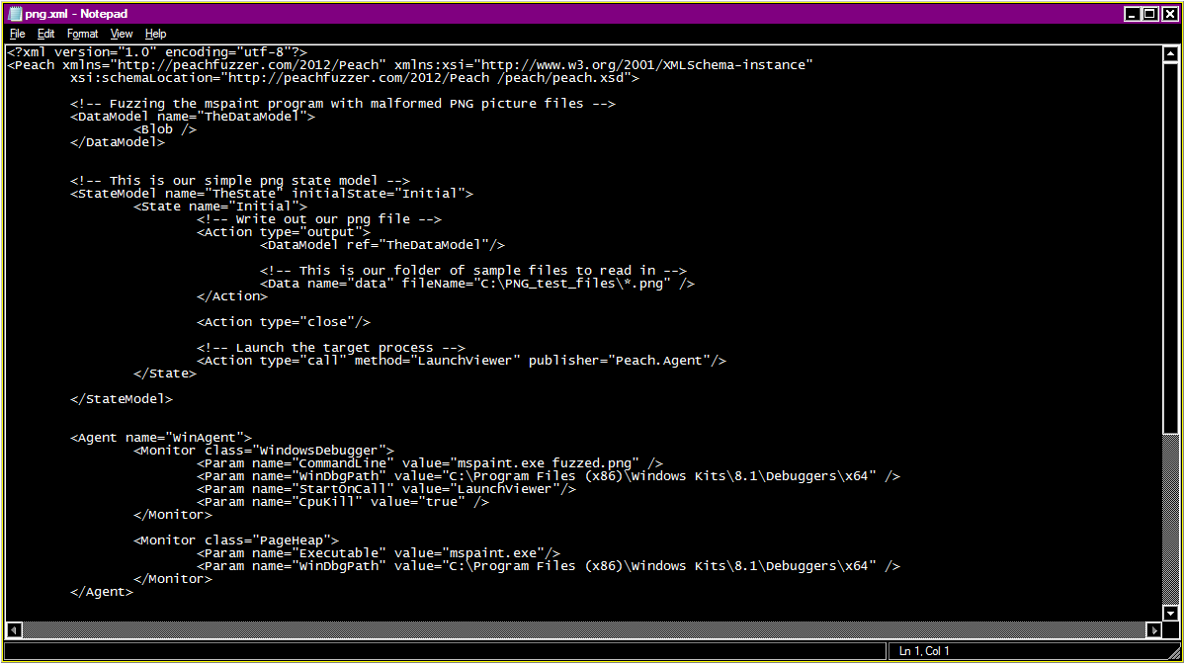
Notes:
Discuss data model, state model, agent
Data model describes the data including type information, relationships (size, count, offsets), and other information that allows the fuzzer to perform smart mutations.
StateModel recreates the basic state machine logic needed to test a protocol. The state model defines how to send and receive data to the fuzzing target
Action is a way of sending commands.
Agents are special Peach processes that can be run locally or remote. These processes host one or more Monitors that can perform such actions as attaching debuggers, watching memory consumption, detecting Faults, etc.

Slide 13
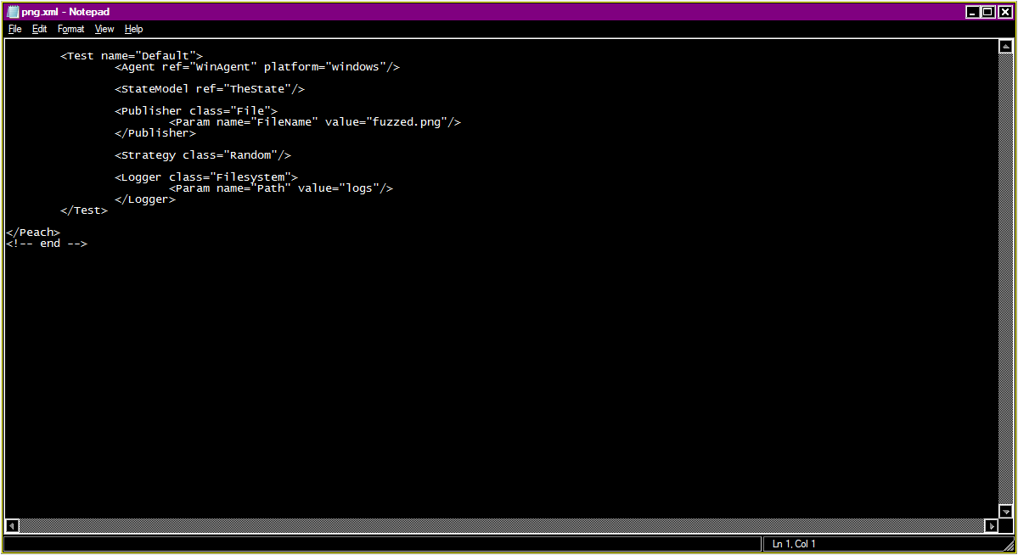
Notes:
A test sums up everything needed to do a fuzzing run
Publisher is an I/O interface for interacting with the fuzzing target.
Strategy defines how to perform data mutations across fuzzing iterations (optional, defaults to RandomDeterministic…has a start and end and the order of mutations has been shuffled; good for everything I’ve done so far)
Logger tells Peach how to log crashes. In this case, the logs will be written to C:\Peach Fuzzer\logs
Will have log examples in a while

Slide 14
Peach pit to fuzz a command line program which takes one argument

Slide 15
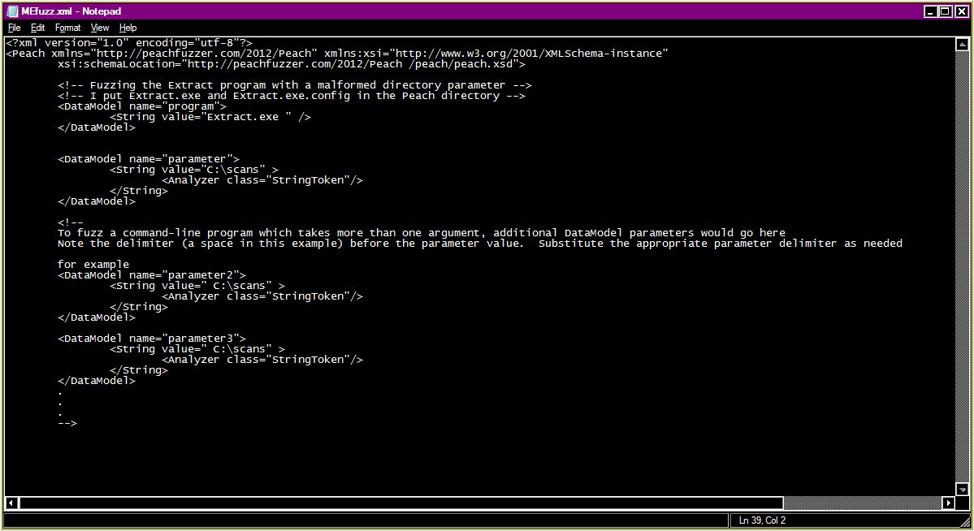
Notes:
Here, data model describes the command line program and its parameter

Slide 16
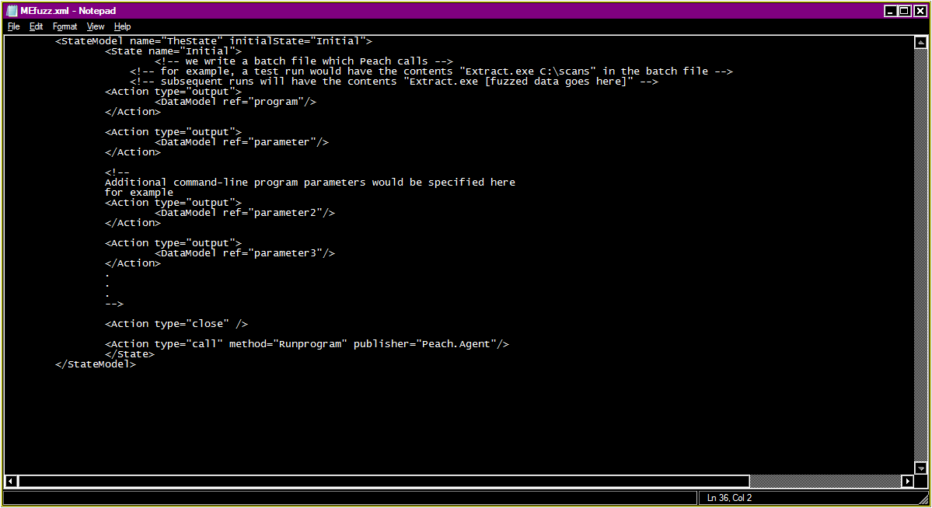
Notes:
State defines the call_program.bat file, which will contain the following
Extract.exe fuzzdata

Slide 17
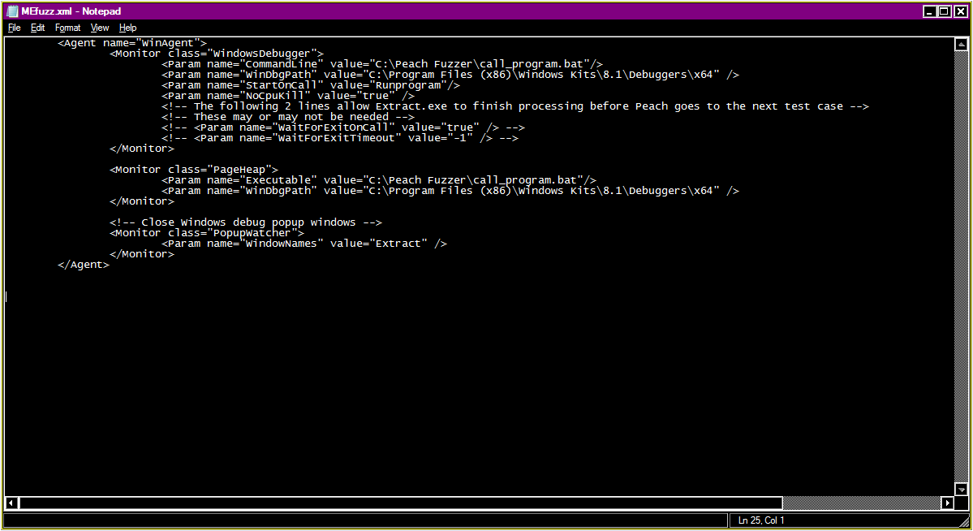
Notes:
Agents host monitors…they are usually operating system specific
Monitor is something that Peach will do (e.g. attach debugger, watch memory consumption, etc)
WinDbgPath – optional, but Peach usually can’t find it, so you have to specify it. This is the default when you install the MS debugging tools
StartOnCall — Debugger will not be attached until matching call is made from state model
NoCpuKill — Don’t use process CPU usage to terminate early. Defaults to false, but you may want to set this to true, if your fuzzing target program is memory-intensive.

Slide 18
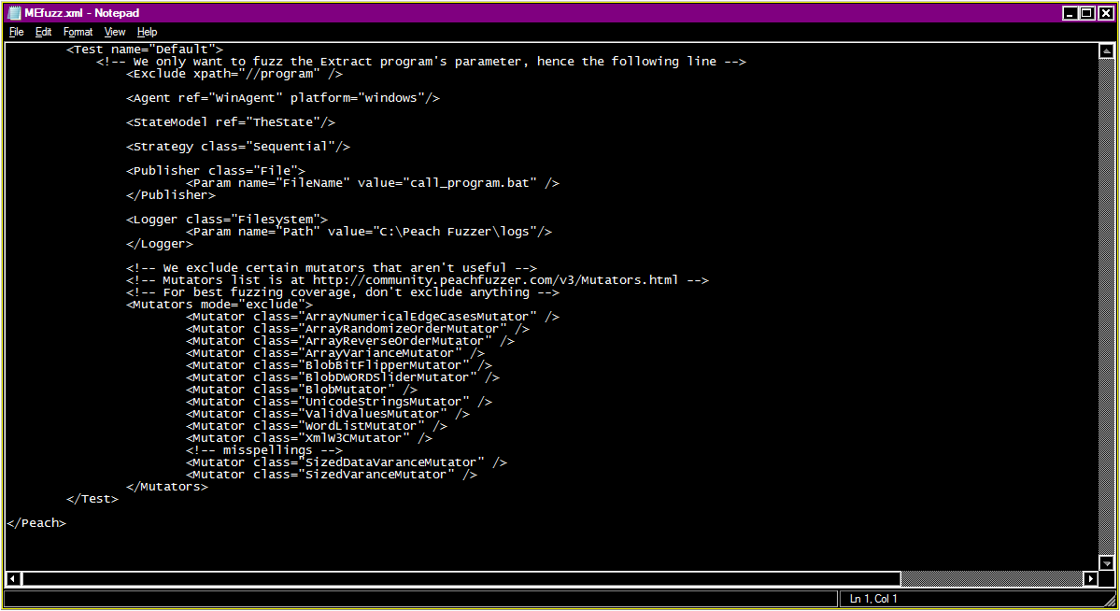
Notes:
Test puts everything together for a fuzzing run
Note exclude part
Note mutators node…
Note the misspellings!

Slide 19
Peach fuzzer logging
Notes:
Show directories
MEfuzz.xml errors
Mefuzz.xml false positive
These are from a fuzzing run on a 64-bit Windows 7 PC

Slide 20
BurpSuite
Not a fuzzer, per se, but I’ve used Repeater for manual fuzzing
My preferred tool for manual fuzzing of web applications
Decoder and Comparer are quite handy, too

Slide 21
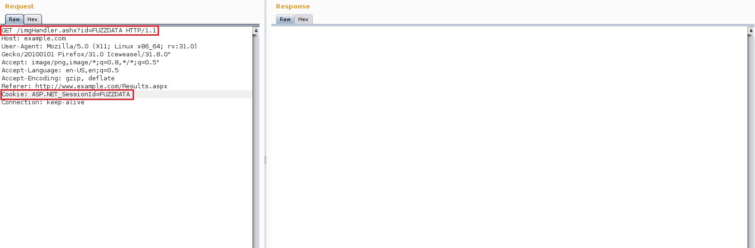

Slide 22

Kali Linux fuzzing tools

Slide 23
BED
Network protocol fuzzer
FTP, SMTP, POP, HTTP, and a few others
Uses a set list of strings for fuzzing, so it doesn’t do mutation
You can add your own strings by changing the code (it’s Perl)
General-use fuzzer…”fire and forget”
Might want to mod, depending on your target
I start a packet capture before running BED, so I get better visibility into what caused a crash
Notes:
Should be around the ½ hour mark now

Slide 24
BED fuzz strings
my @overflowstrings = ("A" x 33, "A" x 254, "A" x 255, "A" x 1023, "A" x 1024, "A" x 2047, "A" x 2048, "A" x 5000, "A" x 10000, "\\" x 200, "/" x 200);
my @formatstrings = ("%s" x 4, "%s" x 8, "%s" x 15, "%s" x 30, "%.1024d", "%.2048d", "%.4096d");
# three ansi overflows, two ansi format strings, two OEM Format Strings
my @unicodestrings = ("\0x99"x4, "\0x99"x512, "\0x99"x1024, "\0xCD"x10, "\0xCD"x40, "\0xCB"x10, "\0xCB"x40);
my @largenumbers = ("255", "256", "257", "65535", "65536", "65537", "16777215", "16777216", "16777217", "0xfffffff", "-1", "-268435455", "-20");
my @miscstrings = ("/", "%0xa", "+", "<", ">", "%". "-", "+", "*", ".", ":", "&", "%u000", "\r", "\r\n", "\n");

Slide 25
DOONA
Expansion/fork of BED
Network protocol fuzzer
FTP, SMTP, POP, HTTP, and a few others
Uses a more comprehensive list of fuzz strings
Also written in Perl, so you can add your own fuzz strings if you want
Another general-use “fire and forget” fuzzer
Consider modding…depending on your target
I start a packet capture before running DOONA, so I get better visibility into what caused a crash

Slide 26
DOONA fuzz strings
my @overflowstrings = ("A" x 33, "A" x 254, "A" x 255, "A" x 1023, "A" x 1024, "A" x 2047, "A" x 2048, "A" x 5000, "A" x 10000, "\\" x 200, "/" x 200, " " x 9000, "AA " x 200);
my @formatstrings = ("%s" x 4, "%s%p%x%d", "%s" x 8, "%s" x 15, "%s" x 30, "%.1024d", "%.2048d", "%.4096d", '%@' x 53, "%.16i705u%2\$hn", "%#123456x");
# three ansi overflows, two ansi format strings, two OEM Format Strings
my @unicodestrings = ("\x99" x 4, "\x99" x 512, "\x99" x 1024, "\xCD" x 10, "\xCD" x 40, "\xCB" x 10, "\xCB"x40);
my @largenumbers = ("255", "256", "257", "65535", "65536", "65537", "16777215", "16777216", "16777217", "2147483647", "2147483648", "2147483649", "0xfffffffe", "0xffffffff", "4294967295", "9223372036854775807", "18446744073709551615", "-1", "-268435455", "-20", "2.2250738585072011e-308");
my @miscstrings = ("/", "\\", "%0xa", " ", "+", "<", ">", "<>", "%", "-", "+", "*", ".", ":", "&", "%u000", "\t", "\r", "\r\n", "\n");

Slide 27
DotDotPwn
Good for finding directory traversal problems
I had to edit /usr/share/dotdotpwn/DotDotPwn/TraversalEngine.pm to account for specific target files I was seeking at the time
Also written in Perl, so it’s fairly easy to modify
I typically run this after doing a fair amount of recon
Use parameters -E and -X (extra files & bisection algorithm, respectively)
If using on a webserver, don’t forget -M (switch HTTP methods)

Slide 28
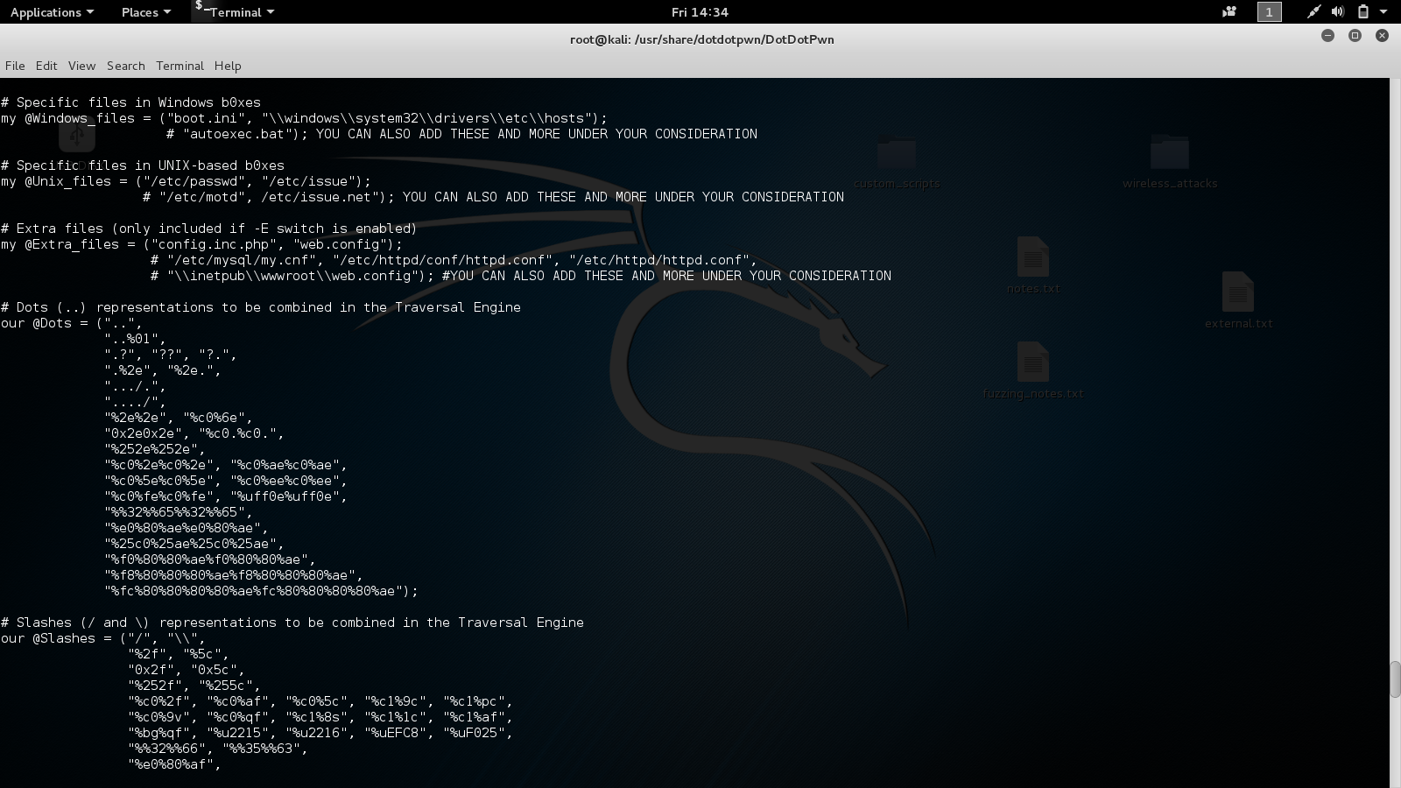
Notes:
I edited the extra files section

Slide 29
Metasploit fuzzer modules
Currently have fuzzers for DNS, SMTP, SMB, HTTP, and a couple other protocols
See /usr/share/metasploit-framework/modules/auxiliary/fuzzers
Or do “search fuzzer” within msfconsole
Have had success with the SMB and HTTP fuzzers
Some modules support the THREADS parameter…increase if you like
Provides good feedback on what caused a crash, but I still run a packet capture when using these
See /usr/share/metasploit-framework/lib/msf/core/auxiliary/fuzzer.rb for details on how fuzz strings are created
Was a good reference for me in customizing my own fuzzers

Slide 30
Metasploit fuzzer modules
tds_login_corrupt and tds_login_username good for fuzzing SQL Server
Might have to edit the Ruby code to send the correct TDS version
Refer to https://msdn.microsoft.com/en-us/library/dd304523.aspx and https://msdn.microsoft.com/en-us/library/dd339982.aspx#Appendix_A_44
2nd link has the TDS versions used in SQL Server
Check out http_form_field, http_get_uri_long, and http_get_uri_strings fuzzers
smb2_negotitate_corrupt is good, too

Slide 31

Nmap fuzzer scripts
More info at https://nmap.org/nsedoc
dns-fuzz
Haven’t had a need for this one yet
http-form-fuzzer
Frequently used this one and found it quite helpful
http-phpself-xss
Haven’t used this one, but looks interesting
All scripts can be found in /usr/share/nmap/scripts

Slide 32
Spike
Difficult to use but powerful
Having a working knowledge of C is helpful
Good tutorial at http://resources.infosecinstitute.com/intro-to-fuzzing/
There are a number of prebuilt spikes in /usr/share/spike/audits that might be useful. They will likely need modification
2 basic commands: generic_send_tcp and generic_send_udp (send TCP and UDP packets, respectively)
Check /usr/share/doc/spike for some limited documentation
Search spike.c for init_fuzz_ints; then look for fuzzstring. Will see many of the fuzz strings used
Note that default Kali Linux does NOT come with the Spike source; see fuzzing.org (SPIKEfile link)

Slide 33
Spike for fuzzing HTTP get

Slide 34
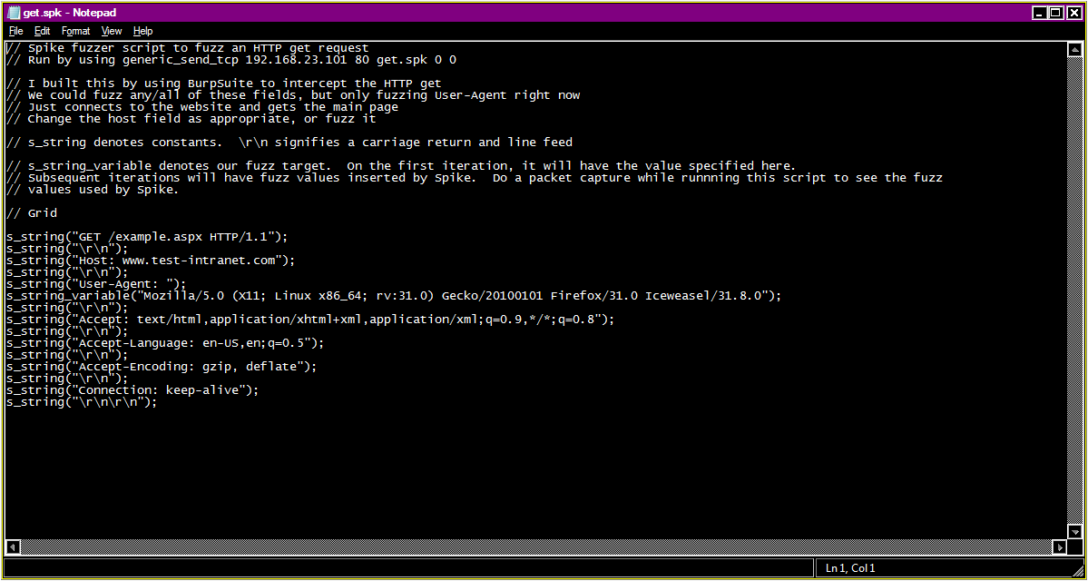

Slide 35
Another Spike for fuzzing HTTP get

Slide 36
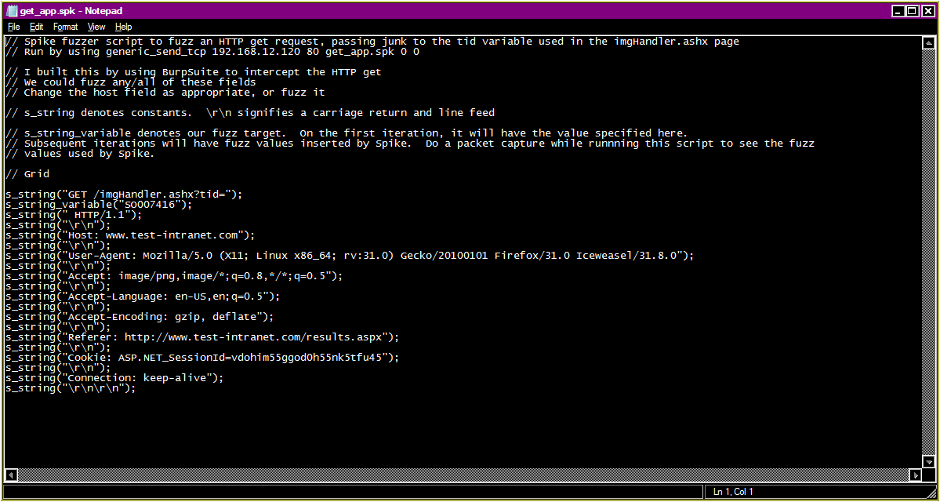

Slide 37
Fuzzing WebResource.axd with Spike

Slide 38
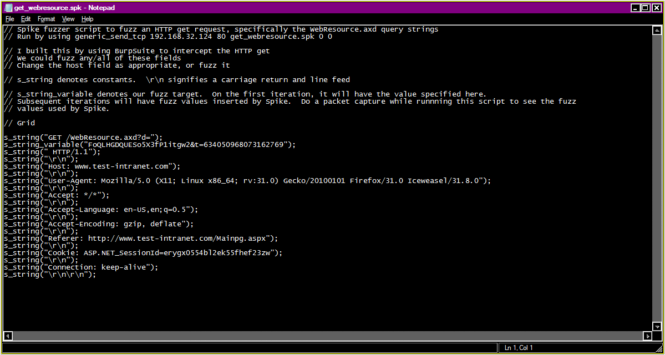

Slide 39
Spike for HTTP post request

Slide 40
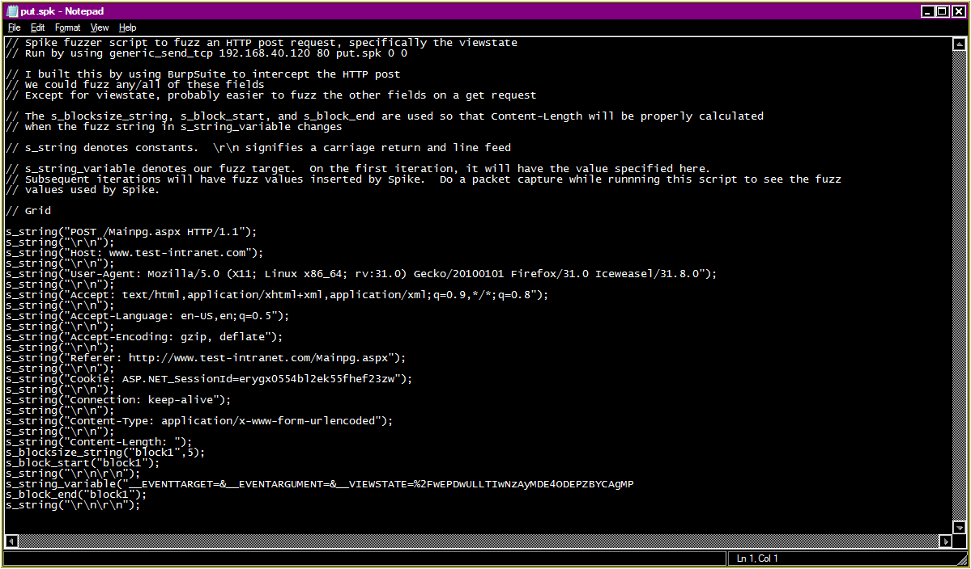

Slide 41
Peach Fuzzer on Kali Linux
See http://community.peachfuzzer.com for further info
Needs Mono packages (just do apt-get install mono-complete on Ubuntu/Debian distros)
Peach pits (fuzz definitions) are done in XML, so a good XML editor is helpful
Free peach pits are available on the Internet
Provides good feedback on reproducing crashes, and logging info useful for exploit development
Good tutorials available at http://community.peachfuzzer.com/v3/PeachQuickStart.html
Also check out https://forums.peachfuzzer.com/forum/peach-community-edition/general-support/410-fuzzing-for-newbies
Notes:
Functions almost the same as on Windows

Slide 42
General tips and tricks
Manually mess around with your target program before launching a fuzzing run against it. Get a good idea of its function and purpose; familiarize yourself with your target.
This will let you know how to tailor your fuzzing
Knowing what input the program expects will give you ideas on what it doesn’t expect
What are the best(worst) inputs I can pass that will cause damage?
Programmers code for certain types of bad input…but it’s nearly impossible to catch all instances
Try mixing special characters and spaces, carriage returns/line feeds, nulls, extra delimiters, etc.
For example “&^^$%$ !!@#%*{}[[[])))’ ‘ &&@@null~~`!!”
Good fuzz strings are stuff like a bunch of spaces, special characters, or format strings (.NET platform examples “{0:N2}” “{0: MM/dd/yyyy}”)
Notes:
Seems to be conflicting information on whether format string attacks are possible in .NET

Slide 43
General tips and tricks, part 2
Get some virtual machine software: VMWare or Oracle VirtualBox
Got spare hardware? Use it for fuzzing practice/testing
This includes wireless access points too!
Fuzzing is disruptive by nature; be prepared to reboot your target.
Make sure appropriate staff is notified about a fuzz: network admins, programmers, etc
dev.modern.ie has free time-limited virtual machines useful for fuzzing targets
www.vulnhub.com has a collection of challenges via downloadable virtual machines
Search www.exploit-db.com for the term fuzzing
2 good write ups are at www.exploit-db.com/papers/12965 and www.exploit-db.com/docs/239.pdf
Start with a short fuzzing run at first, to verify all is well
Even with automated fuzzing, it's good to check now and then

Slide 44
Windows tips and tricks
Simulate production as closely as possible
Watch for anti-virus/anti-malware, including Microsoft EMET
Close open programs
You’ll tend to run your target out of memory, particularly when using Peach Fuzzer
Ctrl-Alt-Del is your friend ☺

Slide 45
Kali Linux tips and tricks
I generally start with BED/DOONA, then progress to other fuzzers as needed…depends on what I’m fuzzing
Currently, BED/DOONA having problems…won’t run on Perl 5.22.2-5?
Fix provided by DOONA developer…thanks, Wireghoul!
Works for BED, too
See https://bugs.kali.org/view.php?id=3608
Check the fuzzer source to ensure it is sending the fuzz strings you expect/want! You may need to customize the fuzz strings, based on your target
Start a packet capture before beginning a fuzzing run, so you can see what caused a crash. Some tools don’t give good feedback.

Slide 46
Questions/Comments?
Samples available at https://github.com/griddd/DerbyCon2016
Make fuzzing part of your development or QA process…it really does help
Might drive your programmers nuts, though ☺
I’ll be around the con…stop and introduce yourself!
diverdown10 at gmail.com

